Slide 1
Clever Support for 3D Printing
CMPT464/764 Course Project
Yiji Wang(301286922)
Jack Anderson(301126642)

Slide 2
Outline
Problem Statement and General approach
Our Implementation
Evaluation
Limitations and ways of improvement
Demo

Slide 3
Outline
Problem Statement and General approach
Our Implementation
Evaluation
Limitations and ways of improvement
Demo

Slide 4
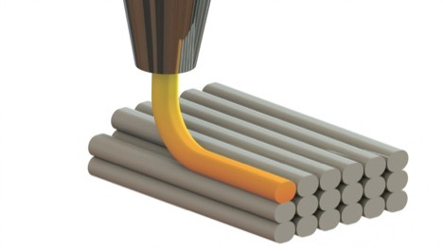
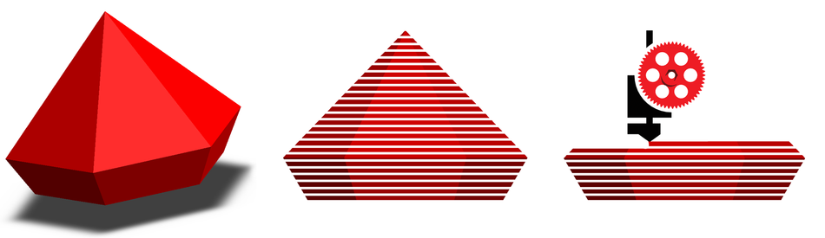
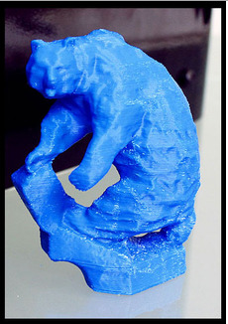
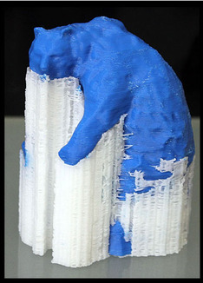
3D Printing
Quick prototyping
Customized manufacturing
Complex shapes
Little waste
?
Image Source:http://maker.tufts.edu/handbooks/3d-printing/about
http://3devo.eu/wp-content/uploads/2015/08/Desiging-for-3D-Printing-1.jpg
http://hotmess3d.com/iimg/265/950x/i.png

Slide 5
General Approach
Support inserted as vertical columns connecting overhang parts with printing layer
Fused Deposition Modeling(FDM) printers: use main printing material for support
Stereolitography(SLA) printers: use cheap material for support, price of support=half price of main printing material
Reference:J. Vanek, J. A. G. Galicia, and B. Benes. Clever support: Efficient support structure generation for digital fabrication. 2014

Slide 6
Problem Statement
Object:
Generate minimized support structure for the objects for 3D printing
Input:
3D model represented a boundary mesh in obj/smf file
Critical Angle
Sampling Distance
Type of support structure
Thickness of material
Output: 3D model with minimum tree-like support structure for 3D printing in obj/smf file

Slide 7
Outline
Problem Statement and General approach
Our Implementation
Evaluation
Limitations and ways of improvement
Demo

Slide 8
Clever Support: Efficient Support Structure Generation for Digital Fabrication
J. Vanek, J. A. G. Galicia, and B. Benes.
Eurographics Symposium on Geometry Processing, 2014

Slide 9
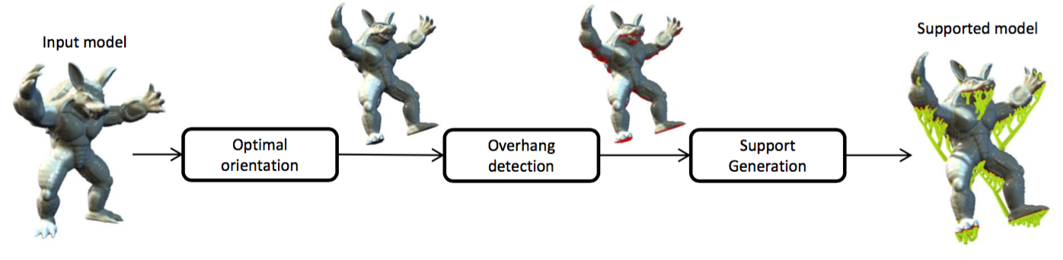
System Pipeline
Optimal Orientation
Overhang detection
Support Generation
Image Source: J. Vanek, J. A. G. Galicia, and B. Benes. Clever support: Efficient support structure generation for digital fabrication. 2014

Slide 10
Work Distribution
Jack
N/X structure
Yiji
User Interface
Optimal orientation
Overhang Detection
Support tree structure generation
Evaluation

Slide 11
System Pipeline
Optimal Orientation
Overhang detection
Support Generation
Image Source: J. Vanek, J. A. G. Galicia, and B. Benes. Clever support: Efficient support structure generation for digital fabrication. 2014

Slide 12
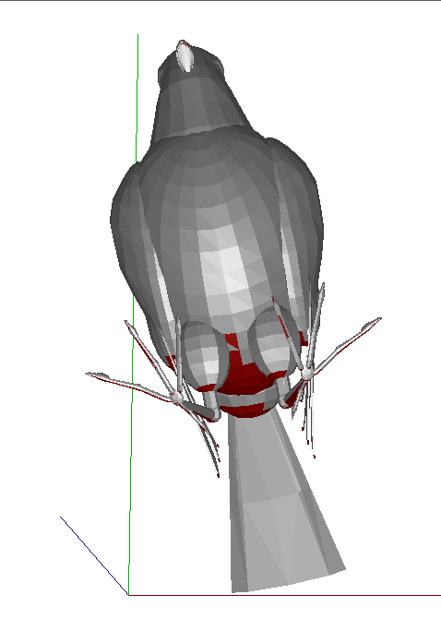
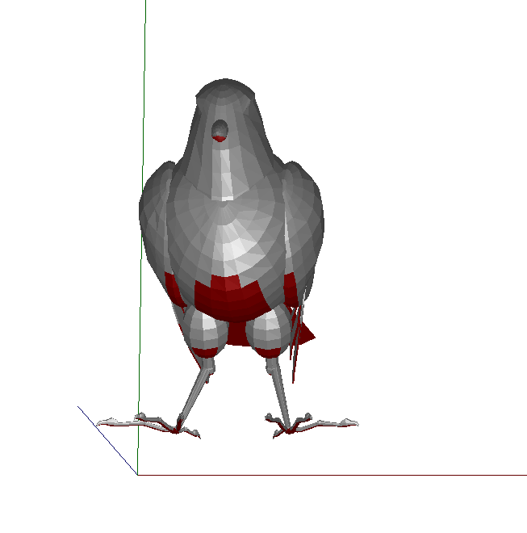
Find Optimal Orientation
Left: Orignial Orientation, Right: Best Orientation in 50 random cases
Critical Angle=50
Find the best orientation with least overhanging points among K random orientation
Cannot guarantee the printability of the model.

Slide 13
System Pipeline
Optimal Orientation
Overhang detection
Support Generation

Slide 14
Overhang Detection
Overhang part detection
Uniform sampling

Slide 15
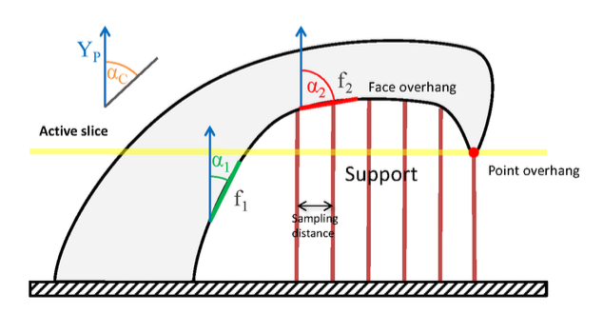
Overhang Detection
Overhang part detection
Image Source: J. Vanek, J. A. G. Galicia, and B. Benes. Clever support: Efficient support structure generation for digital fabrication. 2014

Slide 16
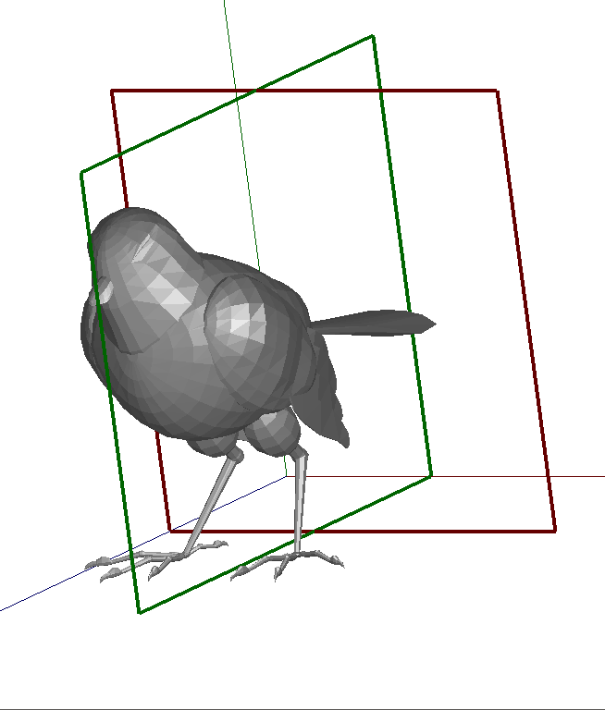
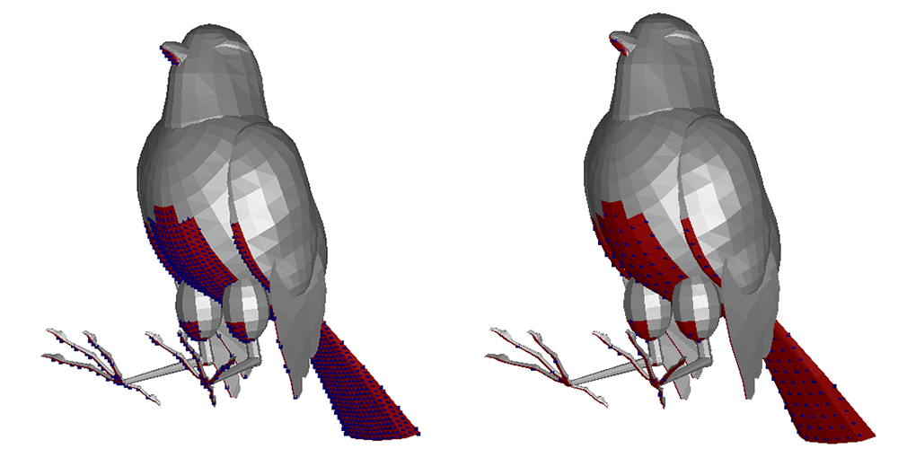
Overhang Detection
Uniform Sampling
Software scan-line rasterization algorithm
Sampling Distance
Left:0.1mm
Right:0.25mm
Reference:Software rasterization algorithms for filling triangles. http://www.sunshine2k.de/coding/java/TriangleRasterization/Triangle- Rasterization.html.

Slide 17
System Pipeline
Optimal Orientation
Overhang detection
Support Generation
Image Source: J. Vanek, J. A. G. Galicia, and B. Benes. Clever support: Efficient support structure generation for digital fabrication. 2014

Slide 18
Support Generation
Build Support Tree
Wrap Tree with N/X Structure

Slide 19
Support Generation
Build Support Tree
Wrap Tree with N/X Structure

Slide 20
Support Generation
Build Support Tree
Cones for overhanging points
Best intersection point for cones
Progressively build the tree
Detect the mesh-cone intersection

Slide 21
Support Generation
Build Support Tree
Cones for overhanging points
Best intersection point for cones
Progressively build the tree
Detect the mesh-cone intersection

Slide 22
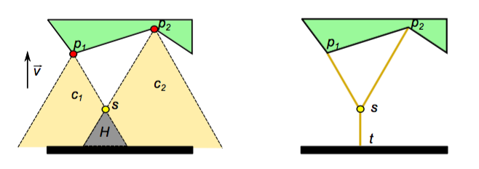
Cones for Overhanging Points
Each overhanging point will have a corresponding cone. The size of cone is decided by the height of point and the critical angle
Image Source: J. Vanek, J. A. G. Galicia, and B. Benes. Clever support: Efficient support structure generation for digital fabrication. 2014

Slide 23
Support Generation
Build Support Tree
Cones for overhanging points
Best intersection point for cones
Progressively build the tree
Detect the mesh-cone intersection

Slide 24
Best intersection point of cones
http://www.grad.hr/geomteh3d/prodori/princip_stst.swf

Slide 25
Support Generation
Build Support Tree
Cones for overhanging points
Best intersection point for cones
Progressively build the tree
Detect the mesh-cone intersection

Slide 26
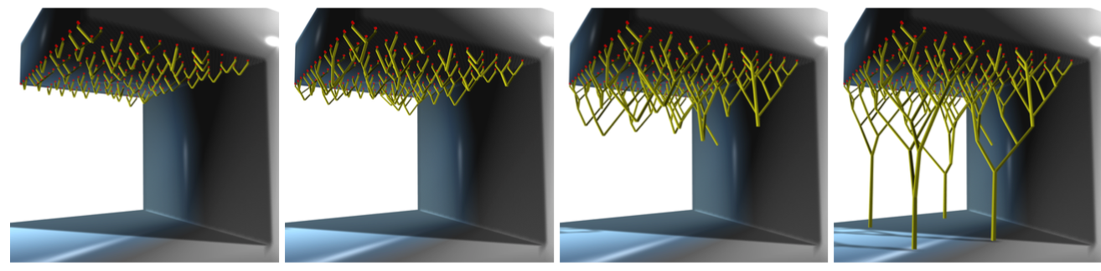
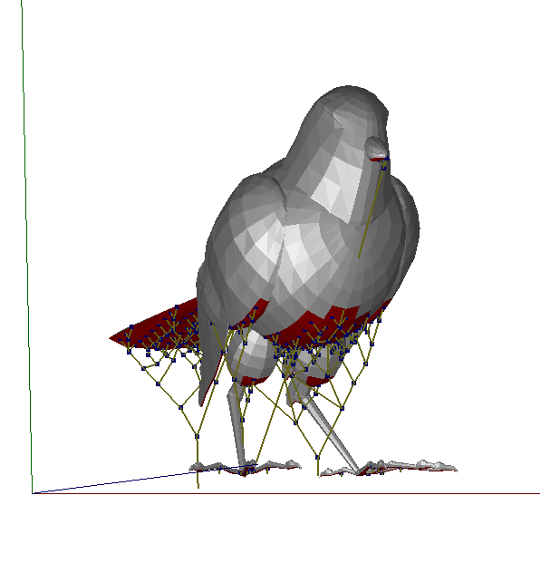
Progressively build the tree
Sort Overhanging point list P from top to bottom
Start from top point P1, find the closest point P2
Find the corresponding cones C1 and C2
Find the cone intersection S
Delete P1, P2 from P
Put S into P
Repeat 2~6 until P is empty
Image Source: J. Vanek, J. A. G. Galicia, and B. Benes. Clever support: Efficient support structure generation for digital fabrication. 2014

Slide 27
Support Generation
Build Support Tree
Cones for overhanging points
Best intersection point for cones
Progressively build the tree
Detect the mesh-cone intersection

Slide 28
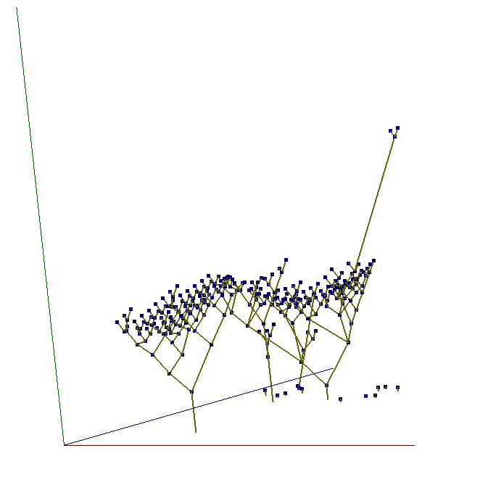
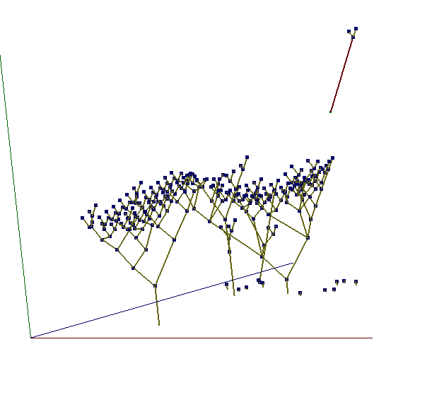
Detect the mesh-cone intersection
Image on the left shows the original tree structure
Image on the right, the intersection of cone and the mesh is detected and the branch is in red

Slide 29
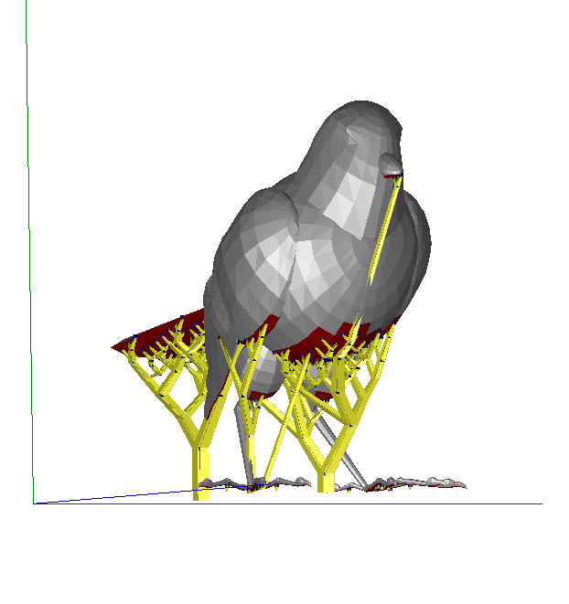
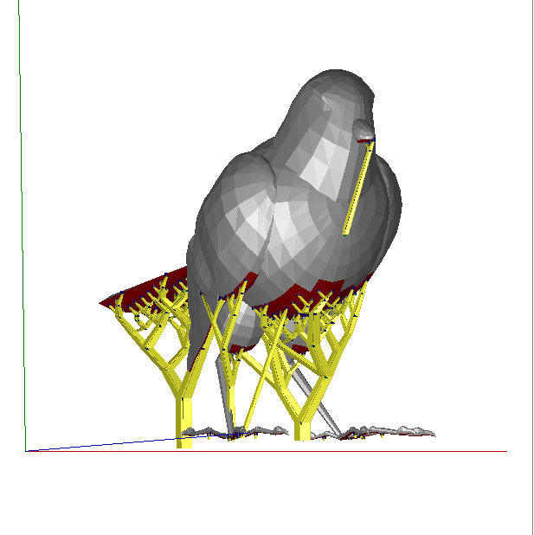
Detect the mesh-cone intersection
Without collision detection
With collision detection

Slide 30
Support Generation
Build Support Tree
Wrap Tree with N/X Structure

Slide 31
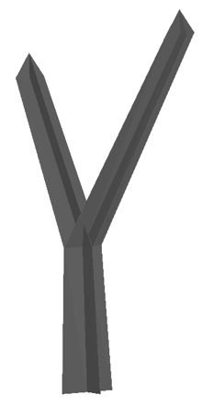
Wrap Tree with N/X structure
Generate vertices on each edge for either shape given a diameter and structure width
Create faces between all vertices

Slide 32

Wrap Tree with N/X structure
Each node is given a strut diameter by the formula d = k*l*α, where l is the length of the line between the two points on either end of the strut, α is the angle between the strut and the printing angle, and k is the length to angle coefficient taken from the paper where k=0.0015. The value for k was determined by experiment.

Slide 33

Wrap Tree with N/X structure
The 'X' structure uses less material than the 'N' structure from the paper when used on some models, the total length of all the line segments in the 'N' structure is 2d+√2 *d (two straight line segments and one diagonal line segment), but the total length of all the line segments in the 'X' structure is 2*√2 *d (two diagonal line segments)
We were not able to test the comparative structural strength of the two types of support structures, but this could be part of future work

Slide 34
Outline
Problem Statement and General approach
Our Implementation
Evaluation
Limitations and ways of improvement
Demo

Slide 35
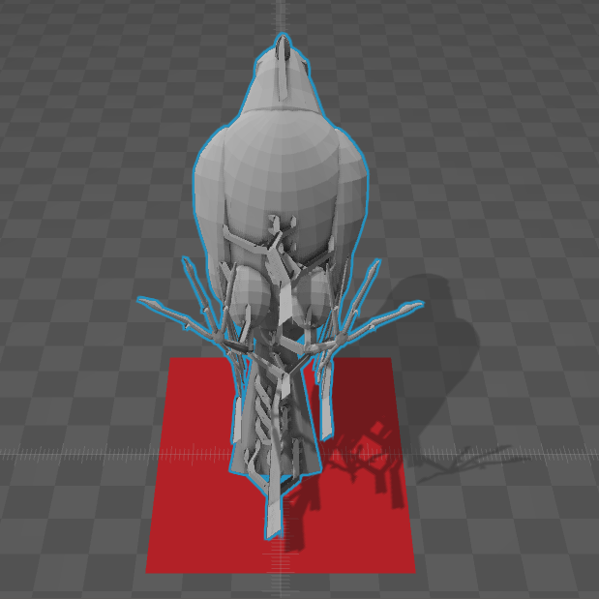
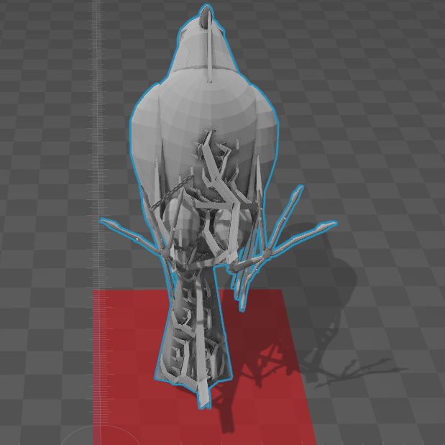
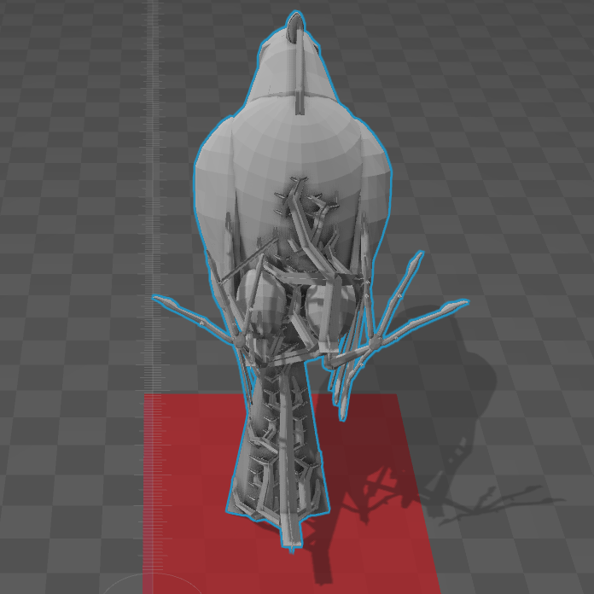
Evaluation
Result from the paper
Our Result(N)
Our Result(X)

Slide 36
Evaluation

Slide 37
Outline
Problem Statement and General approach
Our Implementation
Evaluation
Limitations and ways of improvement
Demo

Slide 38
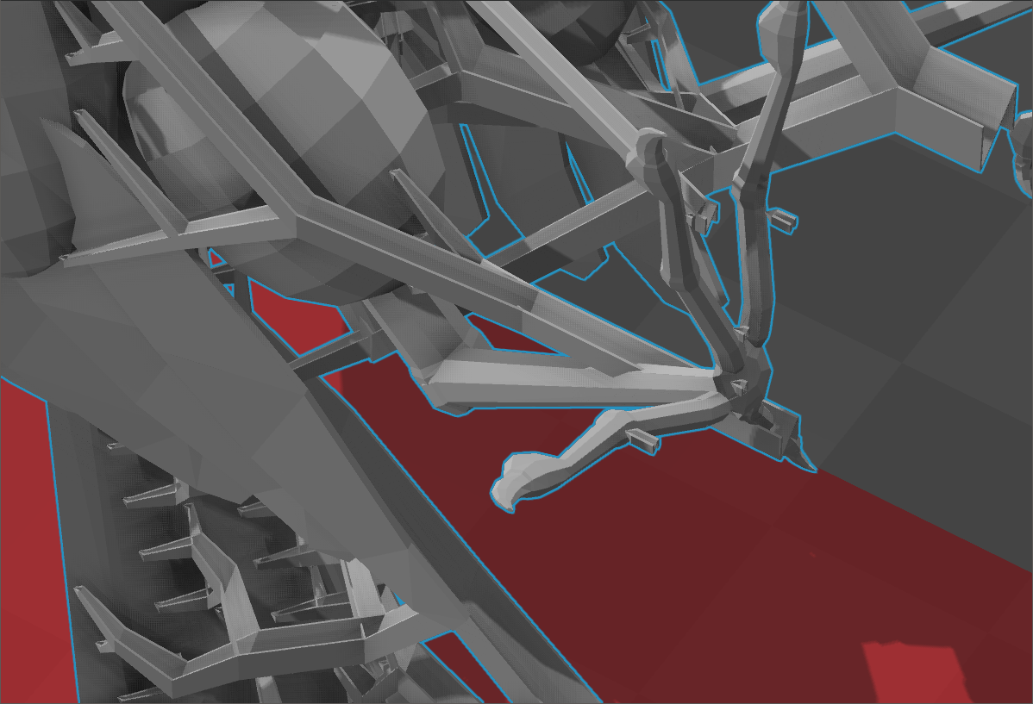
Limitations and ways of improvement
No Structure-mesh collision detection
May check all support structure intersection with the mesh on GPU

Slide 39
Outline
Problem Statement and General approach
Our Implementation
Evaluation
Limitations and ways of improvement
Demo

Slide 40
Q&A

Slide 41
Thank You

